Slide 1

From Reasoning to Agents
Tool Calling and MCP

Slide 2
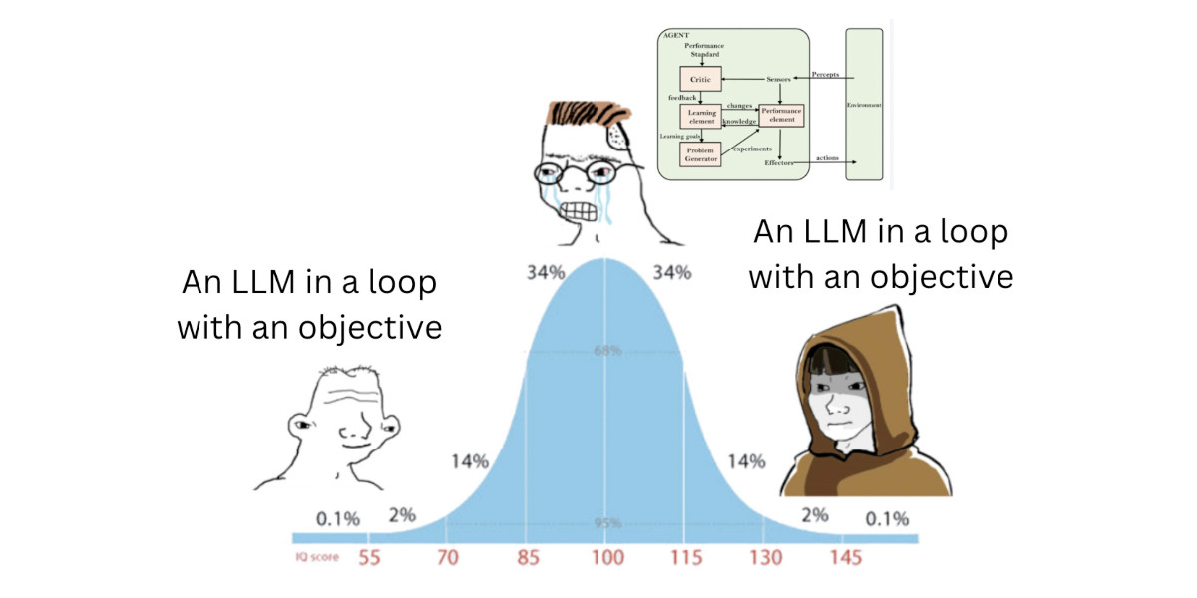
We want to build agents!
LLMs produce text, we want to be able to do things
Two Definitions of “Agent”
  An entity that can observe and change their environment to accomplish a goal
  LLM in a loop with tools
How can these be equivalent?

Slide 3
Reasoning Is Not Enough
Correct Reasoning:
Failed Reasoning:
Question: John takes care of 10 dogs. Each takes 0.5 hours a day to walk. How many hours per week does John spend walking dogs?
Thought: … That is 10 dogs * 0.5 hours / day or 5 hours per day. There are 7 days a week, so 5 hours / day * 7 = 35 hours a week.
Result: Correct
Question: How many molecules of water are in Lake Michigan?
Thought: … Lake Michigan is 2000 cubic miles. There are 4.168 * 10^12 liters per cubic mile. So there are 6.3 * 10^ 10 liters of water in Lake Michigan …
Result: Wrong

Slide 4
What are tools?
Tools - a mechanism for LLMs to access external information during reasoning
Questions:
  How to get an LLM to use tools?
  How do LLM outputs turn into external requests?
Question: How many molecules of water are in Lake Michigan?
Search: “Volume of Lake Michigan”
Calculator: 4.168 * 10^12 x …

Slide 5
Getting a Model To Call Tools
Prompting to the rescue!
ReAct Loop:
[‘Thought’]: <Reasoning here>
[‘Action’]: <Tool call here>
What is the elevation range for the area that the eastern sector of the Colorado orogeny extends into
Thought: I need to search Colorado orogeny, find the area that the eastern sector of the Colorado orogeny extends into, then find the elevation range of the area.
Action: Search[Colorado orogeny]
Observation: The Colorado orogeny was an episode of mountain building (an orogeny) in Colorado and surrounding areas.

Slide 6
Training Data
Tool-Calls push model out-of-distribution
Self-supervised dataset creation
  Given a context, suggest API calls
  Insert <call, result> into text per suggestion
  Perform prediction and select
  Train on new dataset
Tool calling is now embedded into almost all modern models!

Slide 7
Activity: Native Tool Calling
See the starter code in the repository!

Slide 8
Activity Analysis: Native Tool Calling
What goes wrong?
What happens when the model responds with a tool call that doesn’t exist?
What happens when we can’t parse the call correctly?
What happens when the result is not text?
Or the result is too much text?

Slide 9
PydanticAI, LangGraph and Friends!
A graph is a general representation of prompting patterns and tool calling
Reason
Propose
Propose
Propose
Act
Review

Slide 10
Agent Frameworks Example

Slide 11
Activity: Build a Multi-Step Application
See the starter code in the repository!

Slide 12
Bridging between models and tools
The LLM expresses itself in language: e.g., “please run a program to compute X” or “compute the negative log of 0.01”
Meanwhile:
A “tool” might be an executable, Python function, workflow, … •
It might expect input, and produce output, in a variety of formats
It might run on your PC, on an HPC system, in the cloud
It might require specialized permissions to use
The request may refer (implicitly or explicitly) to past interactions
Available tools may change over time or depend on user identity

Slide 13
The problem with tool calling
✗ N models × M tools = N×M integrations
✗ Every team writes their own glue code
✗ No standard auth, schema, or transport
✗ Tool changes break every integration

Slide 14
What is MCP?
Open standard for connecting AI models to external tools and data sources
Solves the N×M problem: one server per tool, works with any model
Client-server architecture: your app hosts a client, tools run as servers
Servers expose three primitives: tools (call), resources (read), prompts (template)
Transport-agnostic: runs over stdio locally, HTTP+SSE remotely
Tools self-describe via JSON schema — the model reads the schema and decides when to call
Adopted broadly: Anthropic, OpenAI, Google, and most major agent frameworks support it

Slide 15
Model (Context Protocol) - The intelligence layer
The model reads tool schemas and decides when and how to call them
It emits tool_use blocks instead of text when it wants to act
It resumes generation once results land back in context
Good schema design is about communicating intent to the model — treat it like documentation for a smart colleague with no other context

Slide 16
(Model) Context (Protocol) - The memory layer
The context window is everything the model knows for that session — system prompt, conversation history, every tool call, every result
It's append-only and finite — every tool result burns tokens permanently
Tool results can be huge; design tools to return answers not dumps
Strategies: summarize before returning, return excerpts, cap tool calls per session
Between sessions, context resets — the model has no memory unless you explicitly persist it

Slide 17
(Model Context) Protocol - Communication Layer
Standard JSON-RPC 2.0 over stdio (local) or HTTP+SSE (remote)
Three primitives: tools (model-driven), resources (app-driven), prompts (user-driven)
Auth lives here: env vars for local, OAuth for SaaS, API keys for service-to-service
The lifecycle: tools/list at session start → model emits tool_use → agent calls tools/call → result appended → model resumes

Slide 18
MCP primiatives
Tools — the model calls these, causes side effects
Defined with input schema (JSON Schema)
Model decides when to call, what args to pass
Examples: run_query, send_email, create_file
Analogous to POST endpoints
Resources — the model reads these, no side effects
URI-addressed (file:///path, db://table/rows)
Application controls when to load them into context
Examples: a file, a database row, a config blob
Analogous to GET endpoints
Prompts — reusable prompt templates the server exposes
Parameterized: code_review(language="python", style="strict")
User or app selects which prompt to invoke
Useful for standardizing workflows across teams
Analogous to stored procedures

Slide 19
Tool call lifecycle
Model receives the tool list and schemas at the start of the session via tools/list
When the model decides to act, it emits a tool_use block instead of text
Your agent code detects the tool_use block, extracts the tool name and arguments
Agent calls the MCP server with those arguments via tools/call
Server executes and returns a result
Result is appended to the conversation as a tool_result message
Model resumes generation with the result now in context
Loop continues until the model emits plain text with no tool call

Slide 20
Context Management
Every tool call and every result gets appended to the context window permanently for that session
Tool results can be enormous — a read_file on a large codebase can burn thousands of tokens in one call
The model has no memory between sessions — context is all it has
Strategies: summarize results before returning them, return excerpts not full dumps, use resources for large reads so the app controls what gets loaded
Design tools to return answers, not data — "the function is on line 42" not the entire file
Set a max_tokens budget and consider capping the number of tool calls per session
Watch for runaway loops — if no tool is returning a satisfying answer, the model will keep trying

Slide 21
Tool Schema Design
The model reads your schema to decide whether, when, and how to call the tool — bad schemas cause bad calls
Description should say when to use it and when not to, not just what it does
Every parameter needs its own description, not just a name
Use enum for constrained choices — don't make the model guess valid values
State side effects explicitly: "this will send an email", "this deletes permanently, no undo"
A minimal vague description leads to the model calling the tool at the wrong time with wrong arguments
Think of the schema as a contract between you and the model — treat it like documentation for a junior engineer who has no other context

Slide 22
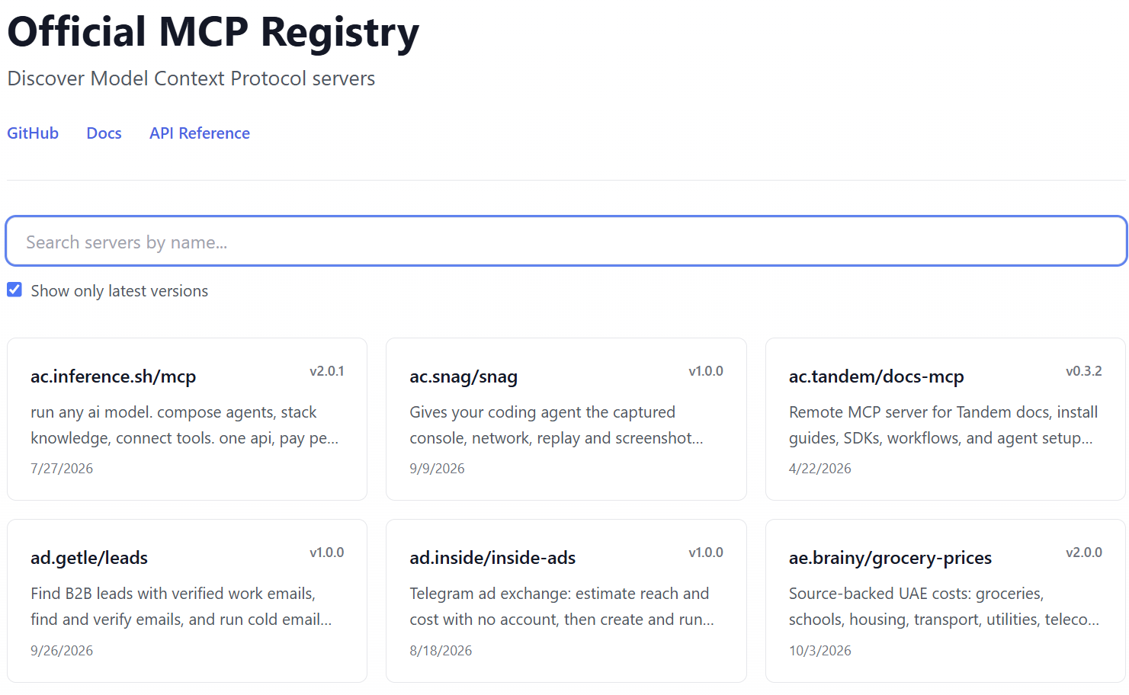
https://registry.modelcontextprotocol.io/

Slide 23

Activity: Building an MCP Server
Goal: build a minimal MCP server, expose 2-3 tools, connect your agent to it
By the end: a fully working custom tool-using agent you wrote top to bottom

Slide 24
Setup
Install: pip install fastmcp
Create server.py
Start it: fastmcp run server.py
Verify: hit tools/list and confirm your server responds

Slide 25
Basic FastMCP Server
from fastmcp import FastMCP
mcp = FastMCP("Demo 🚀")
@mcp.tool
def add(a: int, b: int) -> int:
"""Add two numbers."""
return a + b
if __name__ == "__main__":
mcp.run()

Slide 26
2. Expose your Tools
Add 2-3 tools using the @mcp.tool() decorator
  For example:
Use type hints and docstrings — FastMCP generates the schema from these automatically
Run tools/list again — your tools should appear with full schemas
Checkpoint: does the schema description match what you'd want the model to read?

Slide 27
3. Connect the agent
Point your client at the local server URL
Ask it something that requires using a tool: "log an experiment, then retrieve it"
Print response.content raw — find the tool_use block and read it
Confirm the model chose the right tool with the right arguments
Checkpoint: did the model call the tool you expected, or did it guess wrong? If wrong — fix the schema

Slide 28
Limitations of MCP
Context window pressure — every tool result gets appended permanently; a few large calls can fill the window fast and degrade model performance
Stateless by default — each session starts fresh, servers don't remember previous calls unless you explicitly build persistence in
Latency compounds — a task requiring 5 sequential tool calls is 5 round trips; complex agents can feel slow, especially with remote servers
The model can be wrong — the LLM decides when and how to call tools; it can call the wrong tool, pass bad arguments, or loop unnecessarily — you can't fully control this
Schema is a leaky abstraction — the model reads descriptions in natural language and infers intent; ambiguous or overlapping tool descriptions cause unpredictable behavior
No transactions — if an agent calls three tools and the third fails, there's no rollback; partial side effects are your problem to handle
Auth is bolted on — the spec supports OAuth but implementation varies widely across servers; security model is immature compared to established API standards
Observability is hard — tool calls happen inside the model's reasoning; tracing why the model made a particular call, or debugging a bad sequence, requires extra instrumentation
Still early — the spec is evolving, server quality varies wildly, and breaking changes are possible; the ecosystem is powerful but not yet stable

Slide 29
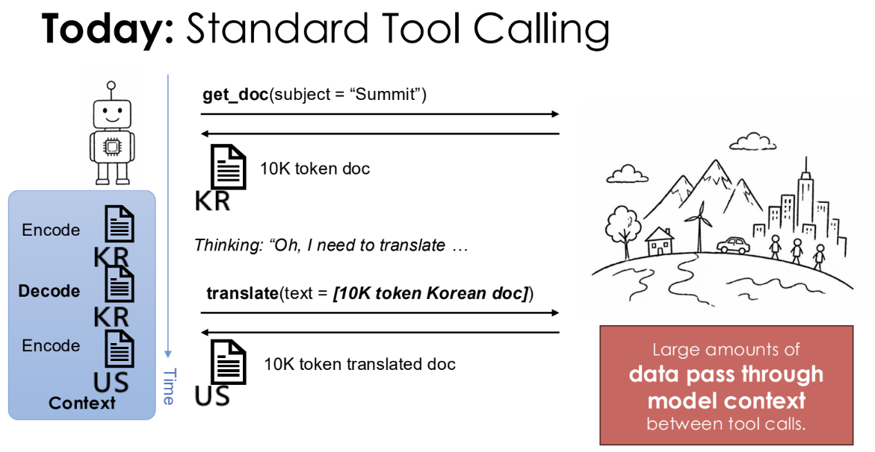
Scalable tool calling: MCP to code execution
Slide: Joseph Gonzalez, LBNL Agents Workshop
Notes:
https://www.anthropic.com/engineering/advanced-tool-use
The Problem with Traditional MCP
Token Bloat: Loading all MCP tool definitions and instructions upfront can consume up to 55,000+ tokens, eating up a large chunk of Claude's context window before a prompt is even answered. [1]
Result Duplication: Chaining multiple MCP tools passes all raw, intermediate tool responses through context, blowing up token costs and leaving room for errors. [1]
How the Python Code Execution Pattern Works
Progressive Disclosure: Instead of loading all tools, only small summaries or names are put in the system prompt.
Code Generation: When Claude needs to use tools, it writes a short Python script to interact with them.
Sandboxed Execution: The generated Python code is executed in an isolated environment (like a container).
Final Result Return: Only the final output or summary of that Python script is sent back to Claude’s context window. [1, 2, 3]

Slide 30
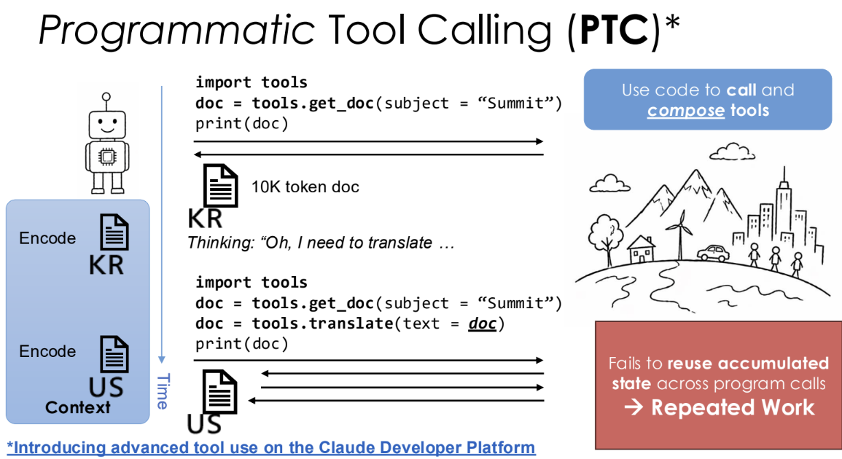
Scalable tool calling: MCP to code execution
Slide: Joseph Gonzalez, LBNL Agents Workshop
Notes:
https://www.anthropic.com/engineering/advanced-tool-use
The Problem with Traditional MCP
Token Bloat: Loading all MCP tool definitions and instructions upfront can consume up to 55,000+ tokens, eating up a large chunk of Claude's context window before a prompt is even answered. [1]
Result Duplication: Chaining multiple MCP tools passes all raw, intermediate tool responses through context, blowing up token costs and leaving room for errors. [1]
How the Python Code Execution Pattern Works
Progressive Disclosure: Instead of loading all tools, only small summaries or names are put in the system prompt.
Code Generation: When Claude needs to use tools, it writes a short Python script to interact with them.
Sandboxed Execution: The generated Python code is executed in an isolated environment (like a container).
Final Result Return: Only the final output or summary of that Python script is sent back to Claude’s context window. [1, 2, 3]

Slide 31

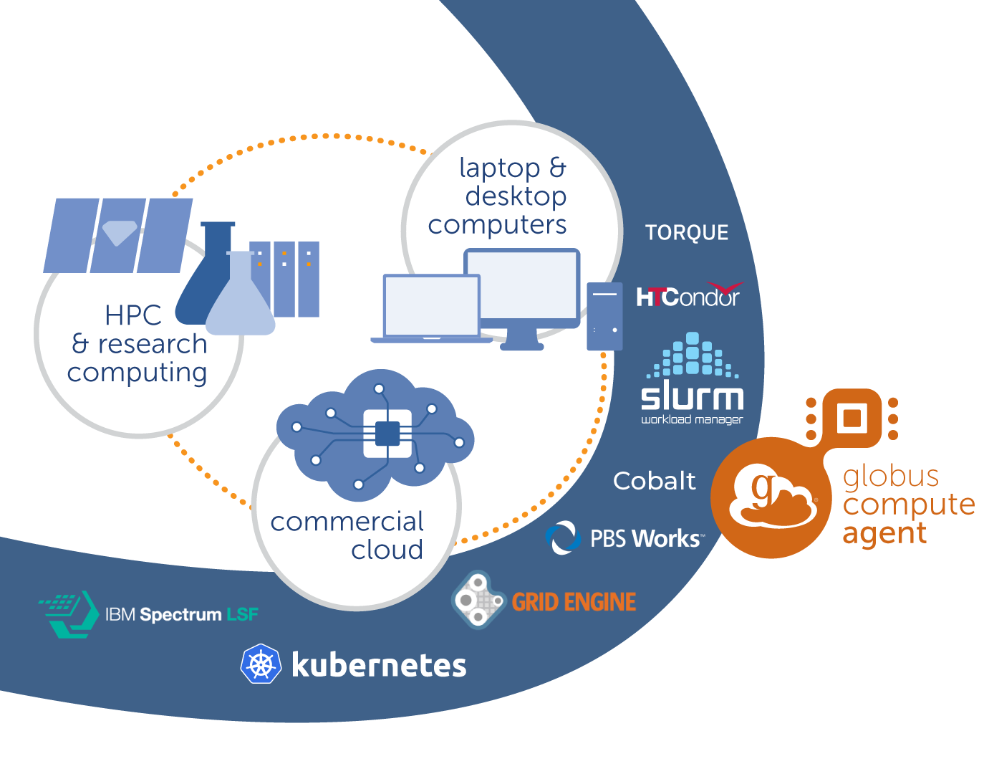
Globus Compute multi-user endpoints
Deploy Globus Compute Software to connect to ecosystem
Asynchronous Python task execution
Persistent pilot that enables interactive (back-and-forth) execution
Environment management
Local policy enforcement
Standard Globus identity mapping for authorization

Slide 32
Python tool calling with Globus
Question - we could show in harness? Or could show via MCP?
https://github.com/academy-agents/caf_hackathon_2026/blob/main/Tutorial.ipynb

